Slide 1
AVL-Trees & B-Trees
Week – 10

Slide 2
Binary Tree
A binary search tree is designed to optimize the cost of insertion and retrieval.
At best and usually they offer O(log n) insertion and retrieval performance.
However, at worst they can degenerate to singly linked lists & only offer O(n) performance.
In which condition?

Slide 3
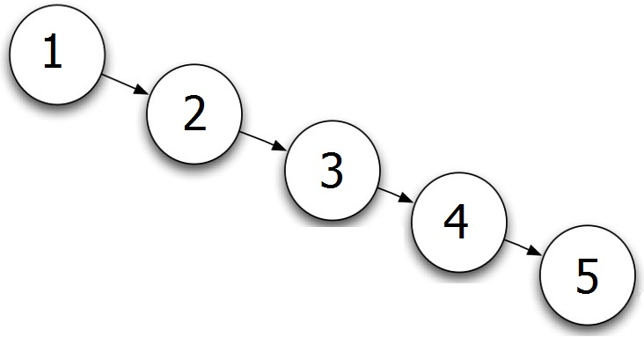
Degenerate Binary Tree
It’s a binary search tree.
Creating a binary search tree with a sorted list of values results in a linear linked list means O(n).
Consider the list below: 1, 2, 3, 4, 5 and its binary tree.
This type of binary tree is called a degenerate binary tree.

Slide 4
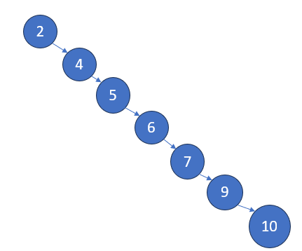
E.g. Create a Binary Tree from the following list: 2, 4, 5, 6, 7, 9, 10.
For example, in the case of a search or retrieval algorithm, we start searching from the root node and will search linearly because each element is greater than 1.
Therefore, a sorted binary tree will result in a linear list. So, the cost will be linear of this binary tree.
So, the cost will be O(n).

Slide 5
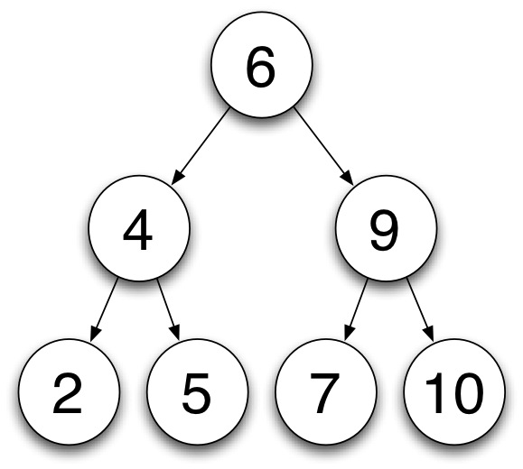
Complete Binary Tree
The opposite of a degenerate binary tree is called a complete binary tree.
A complete binary tree is one where the nodes are equitably distributed between the two sub-trees of a given node also called a balanced tree.
A balanced tree will have a minimal height and optimized cost.

Slide 6
Complete Binary Tree
Degenerate binary search tree
complete binary search tree
the average search cost of a binary search tree is 2 log 2 * log n.
This is approximately 1.39 times the cost of searching a completely balanced tree.
This ideal model is not feasible for random sets of data.

Slide 7
Complete Binary Tree
AVL trees
Degenerate binary search tree
Complete binary search tree
When there is a sorted list given 2, 4, 5, 6, 7, 9, 10, and we need to create a balanced tree, this can be done using the AVL tree.

Slide 8
AVL Binary Search Trees
Adelson-Velski and Landis- (AVL) (1962).
Called Self Balancing Binary Search Tree.
The number of left nodes and right nodes of a given root node cannot differ by more than 1.
Each node has an associated balance factor. It is either left high, equal, or right high.
Left high: The left sub-tree has a height greater than the right sub-tree.
Equal: The left sub-tree has a height equal to the right sub-tree.
Right high: The left sub-tree has a height less than the right sub-tree

Slide 9
Balance Factors for AVL
Balance Factor (BF) is the difference between the height of the left sub-tree (LST) and the right sub-tree (RST).
Balance Factor is calculated by subtracting the height of the right sub-tree from the height of the left sub-tree.
BF = H(LST – RST)
An AVL tree may have nodes with a Balance Factor of 1, 0, or -1
The height of a node is measured starting with its deepest leaf node, tracing its path up the tree.

Slide 10
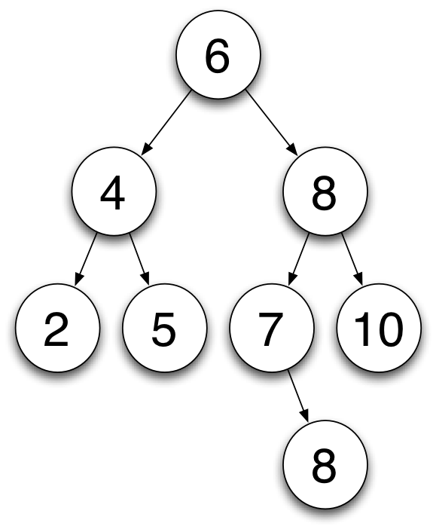
Balance Factors 1
This tree satisfies our conditions of a binary search tree.
Leaf node has always BF = 0.
BF = H(LST – RST) = 0 – 0 = 0
Leaf Nodes have no children, so they have a balance factor = 0.
Why? Because BF = H(LST-RST) and since the leaf node has no sub-trees, it means BF will be 0.
HEIGHT = 2
HEIGHT = 3
HEIGHT = 1
HEIGHT = 2
HEIGHT = 1
HEIGHT = 0
HEIGHT = 0

Slide 11
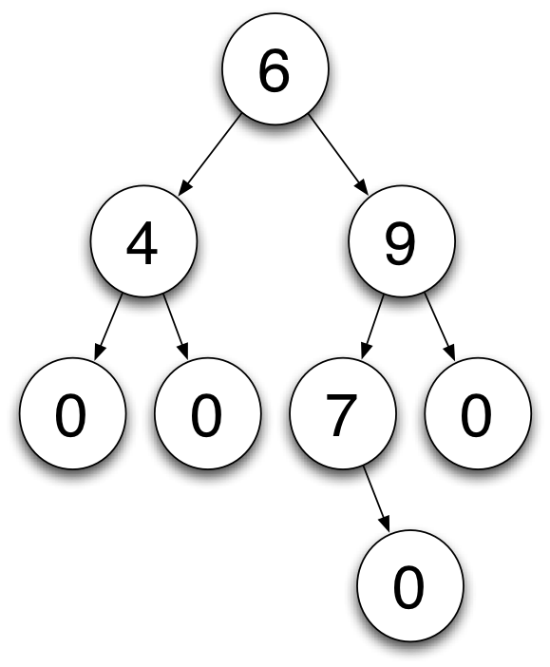

Balance Factors 1
Leaf Nodes have no children so have a balance factor of 0
BF = 0
BF = 0
BF = 0
BF = 0

Slide 12

Balance Factors 1
BF = H(LST – RST)
Balance factor for 4.
H(LST) of 4 = 1, H(RST) of 4 = 1
BF of 4 = H(LST - RST) = (1-1) = 0

Slide 13
Balance Factors 1
BF = H(LST – RST)
Balance factor for 8.
H(LST) of 8 = 2, H(RST) of 8 = 1
BF of 4 = H(LST - RST) = (2-1) = 1

Slide 14
Balance Factors 1
BF = H(LST – RST)
Balance factor for 7.
H(LST) of 7 = 0, H(RST) of 7 = 1
BF of 7 = H(LST - RST) = (0-1) = -1

Slide 15
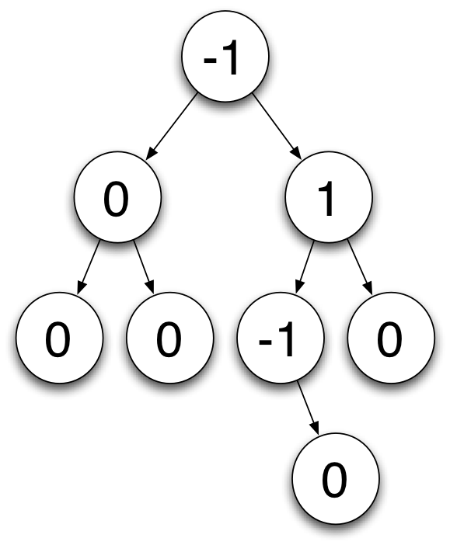
Balance Factors 1
BF = H(LST - RST)
BF for node 6
H(LST) = 2, H(RST) = 3. BF = h(2-3) = -1

Slide 16
Balance Factors
Recalling the statement:
An AVL tree may have nodes with a Balance Factor of 1, 0, or -1
Any BF result in number except 1, 0, -1 will not be an AVL tree.
What if the tree is not balanced?
The solution?

Slide 17
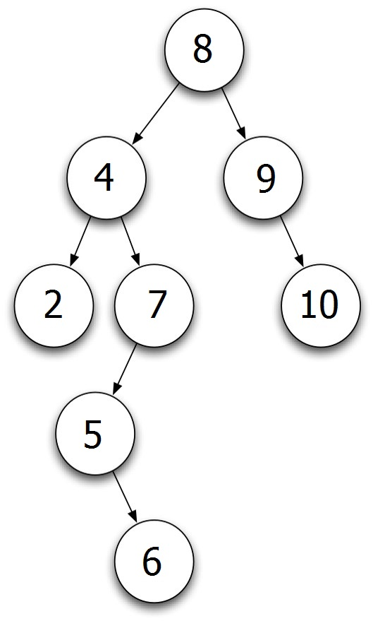
Balance Factors 2
The longest height in this tree is 4.
Leaf Nodes have no children and have a balance factor of 0.
HEIGHT = 4
HEIGHT = 2
HEIGHT = 3
HEIGHT = 1
HEIGHT = 2
HEIGHT = 0
HEIGHT = 1
HEIGHT = 0

Slide 18
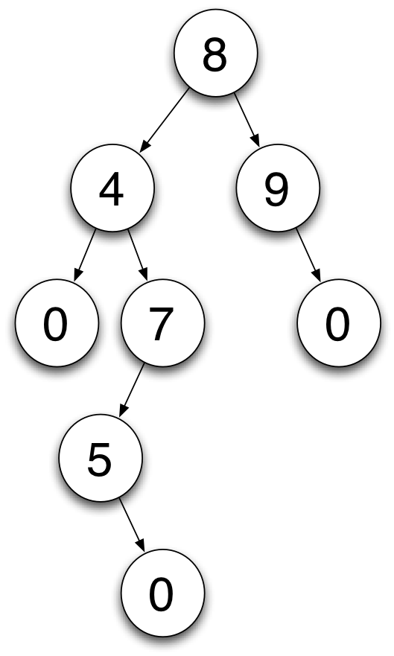
Balance Factors 2
Leaf Nodes have no children as such and have a balance factor of 0.
But according to the definition, it is not an AVL tree.

Slide 19
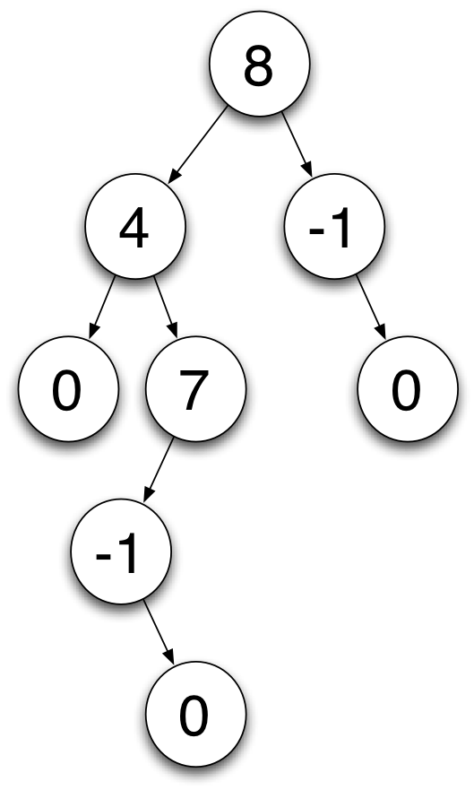
Balance Factors 2
Balance Factor calculated by subtracting the height of the right sub-tree from a height of the left sub-tree.
BF for 5 = 0 – 1 = -1
BF for 9 = 0 -1 = -1

Slide 20

Balance Factors 2
Balance Factor calculated by subtracting the height of the right sub-tree from the height of the left sub-tree.
BF for 7 = 2 – 0 = 2
BF for 4 = 1 – 3 = -2

Slide 21
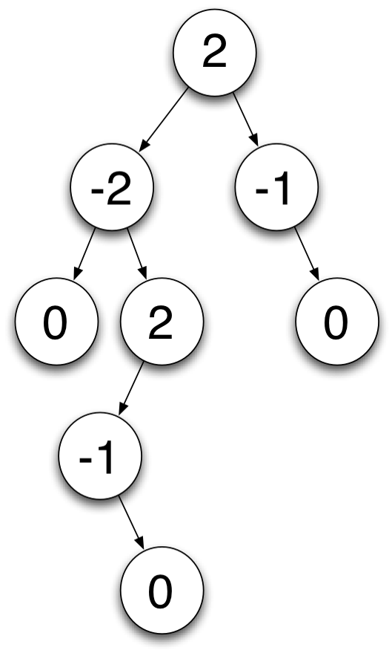
Balance Factors 2
Balance Factor calculated by subtracting the height of the right sub-tree from the height of the left sub-tree.
BF for 8 = 4 – 2 =2

Slide 22
Balance Factors 2
Balance Factor calculated by subtracting the height of the right sub-tree from the height of the left sub-tree.
According to the definition, an AVL tree may have nodes with a Balance Factor of 1, 0, or -1 which is not the case here.
So, it is a binary tree but not an AVL tree.
Every AVL is a binary search tree but not every binary search tree is an AVL tree.

Slide 23
Insertion in AVL Tree
Given an avl tree we want to insert a new element in the tree while keeping its avl property invariant
Inserting a new element proceeds as for insertion in an ordinary binary search tree.
This can cause problems because the tree may become unbalanced.
The tree may need to be re-balanced

Slide 24
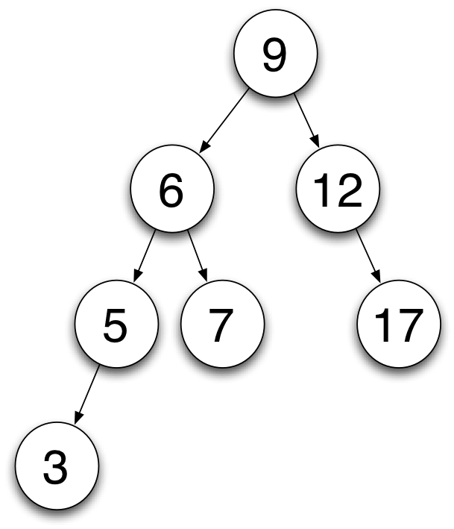
Insertion in AVL Tree
BF = H(LST - RST)
BF of 9 = ?
BF for 6 = ?
BF for 12 = ?
BF for 5 = ?
BF for 7 = ?
BF for 17 = ?
BF for 3 = ?
HEIGHT = 3
HEIGHT = 2
HEIGHT = 2
HEIGHT = 1
HEIGHT = 1
HEIGHT = 1
HEIGHT = 0
HEIGHT = 0
HEIGHT = 0

Slide 25
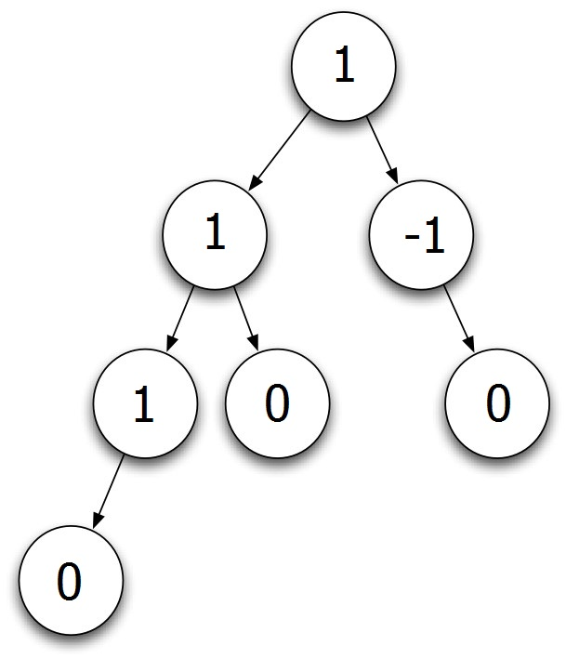
Insertion in AVL Tree
Tree is Balanced and is an AVL tree.

Slide 26
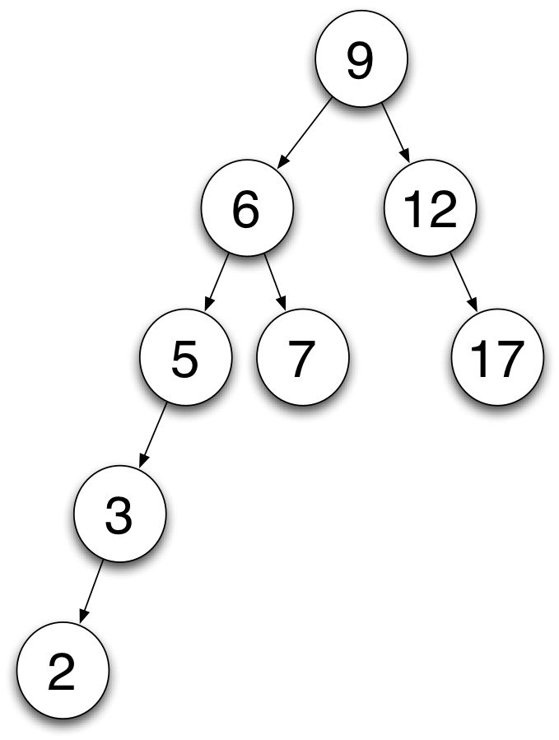
Insertion in AVL Tree
Insert the number 2.
The number will be inserted according to the binary search tree criteria.

Slide 27
Insertion in AVL Tree
Now check the BF after inserting.
BF for 9 = 4 – 2 = 2.
BF for 6 = 3 -1 = 2.
BF for 5 = 2 – 0 = 2

Slide 28
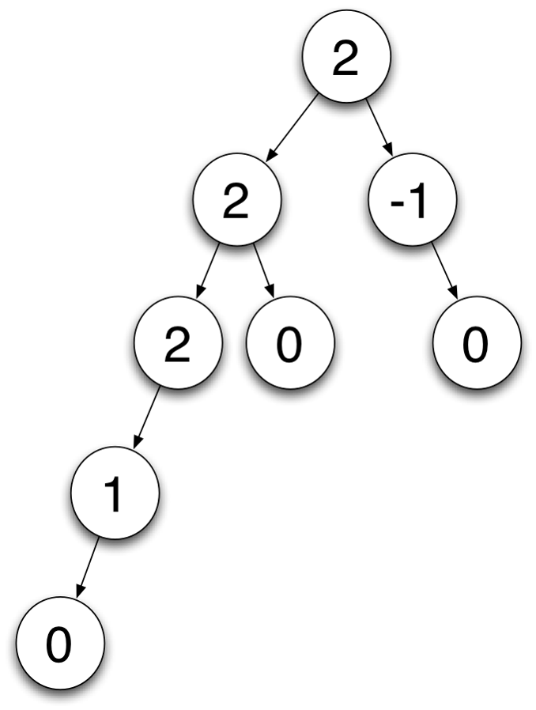
Insertion in AVL Tree
Tree is balanced
Insert the number 2
Tree becomes unbalanced
BF before inserting 2 – Balanced
BF after inserting 2 - Unbalanced

Slide 29

Insertion in AVL Tree
How to get the AVL tree in a balanced way? 1, 0, -1
Consider how you will get the BF for 9 = 1.
Starting at the inserted node and moving up
First node to violate AVL property is 5.
This sub-tree must be rebalanced
grandparent
Inserted grandchild

Slide 30
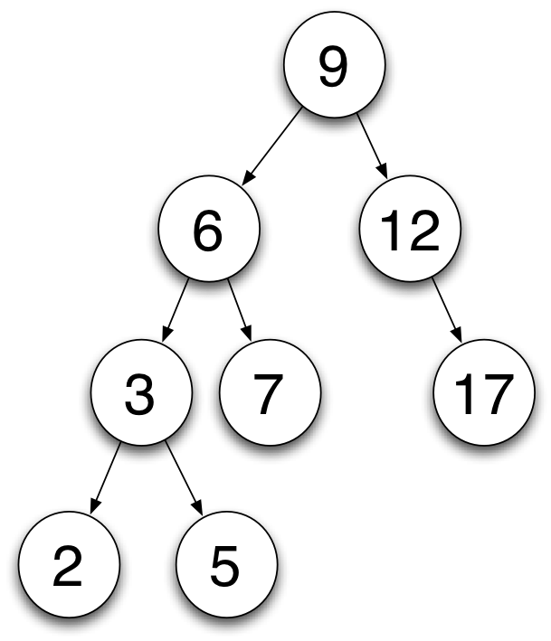
Rebalancing AVL Tree
Inserted Node's Grandparent is placed at right child of it's own child.
Now, this tree is balanced and could be said to be an AVL tree.
BF of 9 = 3-2= 1
BF of 6 = 2-1 = 1
BF of 3 = 1-0 = 1
HEIGHT = 3
HEIGHT = 2
HEIGHT = 2
HEIGHT = 1
HEIGHT = 1
HEIGHT = 1
HEIGHT = 0
HEIGHT = 0
HEIGHT = 0

Slide 31
Rebalancing AVL Tree

Slide 32
Rebalancing AVL Trees
The ordering of the nodes must be maintained.
What we did previously was a rotation.
So, there are two rotations:
Different rotations used to rebalance and maintain order
Two basic rotations
Right rotation
Left rotation

Slide 33
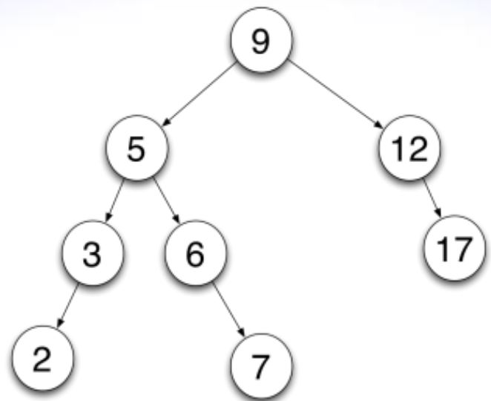
Example of Left Rotation - Exercise
Insert the number 8

Slide 34
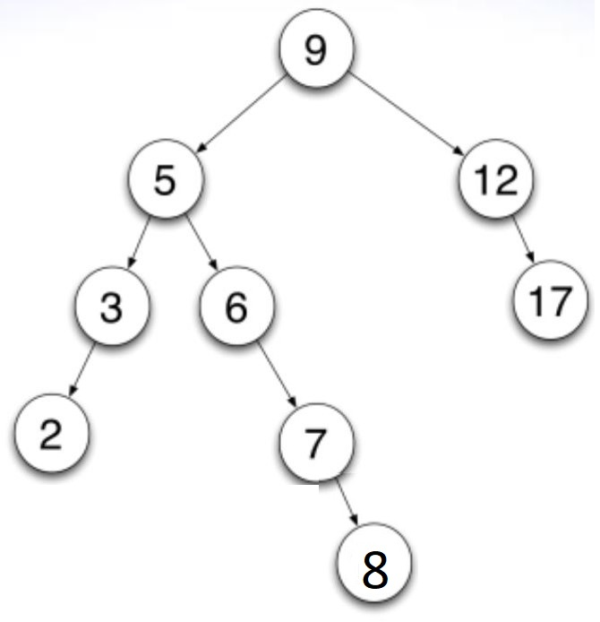

Example of Left Rotation
Left rotation

Slide 35
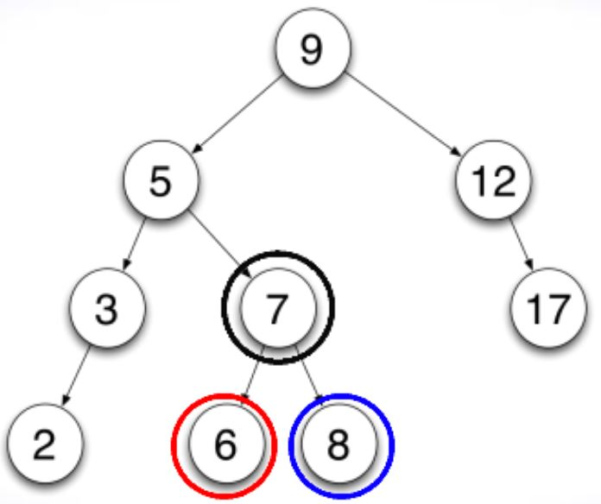
Example of Left Rotation

Slide 36
Complex Rotations
Sometimes one rotation is not enough
Left Right rotation
Right Left rotation

Slide 37
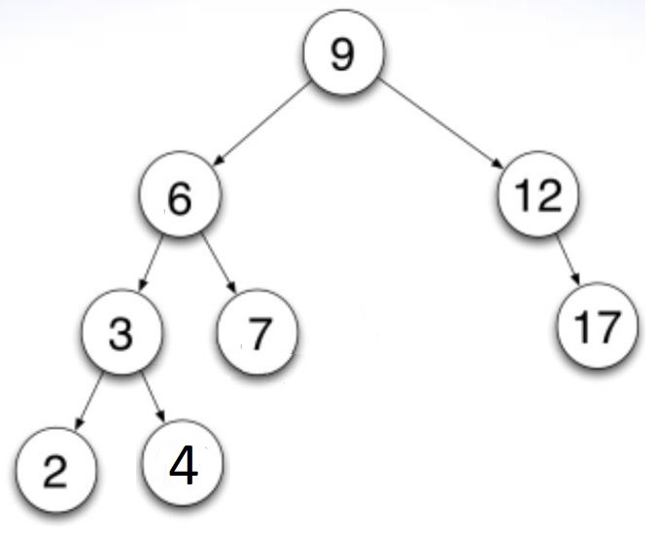
Example of left – right rotation
Balance Factors
Balanced AVL Tree
9 | 1
6 | 1
12 | -1
3 | 0
7 | 0
2 | 0
4 | 0
17 | 0

Slide 38
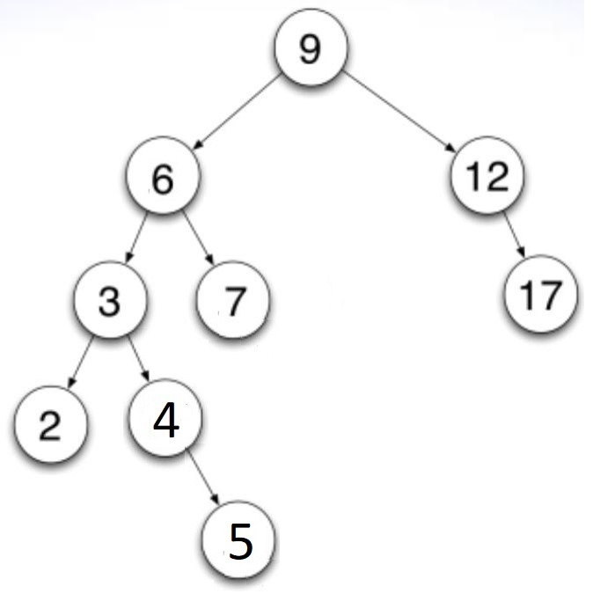
Example of left – right rotation
After inserting 5- the balance goes from -1 to +2.
9 | 2
6 | 2
12 | -1
3 | -1
7 | 0
2 | 0
4 | -1
17 | 0
5 | 0
Left rotation

Slide 39
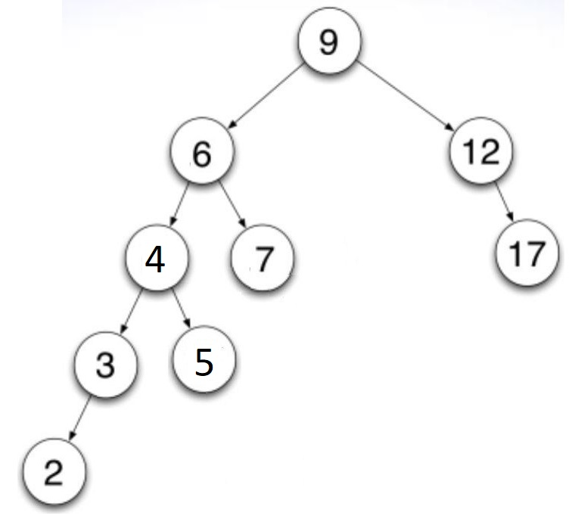
Example of left – right rotation
9 | 2
6 | 2
12 | -1
3 | 1
7 | 0
2 | 0
4 | 1
17 | 0
5 | 0
Left rotation
Even after rotating left, the tree is un-balanced.

Slide 40
Example of left – right rotation
9 | 2
6 | 2
12 | -1
3 | 1
7 | 0
2 | 0
4 | 1
17 | 0
5 | 0
Right rotation

Slide 41
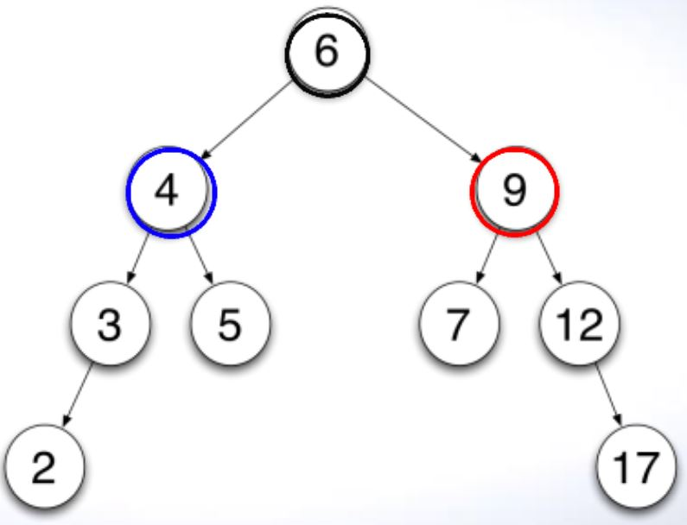
Example of left-right rotation
9 | -1
6 | 0
12 | -1
3 | 1
7 | 0
2 | 0
4 | 1
17 | 0
5 | 0

Slide 42
Visualizer
https://www.cs.usfca.edu/~galles/visualization/AVLtree.html - AVL
https://www.cs.usfca.edu/~galles/visualization/BTree.html - B-Tree

Slide 43
Cost of insertion and retrieval
Cost of insertion and retrieval for AVL binary search tree is (log₂N)
Can we improve on this?

Slide 44
Cost of insertion and retrieval
CPU
Secondary storage with some data
Key | Pointer
CPU
Key | Pointer
……… | ……..
……… | ………..
……….. | ……
Secondary storage with huge data
Key | Pointer
Key | Pointer

Slide 45
B Trees
Introduce multi-way binary search tree where access is to an entire group or page (replaced with nodes) of ordered values (elements/items).
This gives rise to the idea of a page, where the page size corresponds to a multiple of the block size of the underlying storage device.
This choice simplifies and optimizes disk access. Each disk access would read a single page. This can give incredibly fast retrieval times
For example, if the page size was 1000, then, given N items on disk, the cost of retrieval is log₁₀₀₀N. This is an incredibly small number even for huge values of N.
Log₁₀₀₀1000³ = 3*log₁₀₀₀1000 = 3*1 = 3
This means that a tree of height 3 and a branching factor of 1000 can manage a billion keys but only requires at most 3 disk accesses to retrieve a key

Slide 46
B Trees
This whole solution is only possible if a tree is not allowed to grow at random.
The optimum would be to have a perfectly balanced tree. However, this must be ruled out because the balancing overhead is too great
Bayer and McCreight(1972) came up with a solution called B-Tree.
Their suggestion was to define a binary search tree that grows from the bottom up.
Used widely
Operating Systems (Unix file system)
Database Management Systems (to operate a large amount of data when huge memory is required for inserting, searching, and organizing with the help of pages.)

Slide 47
B-Trees
It is a generalization of a BST in which a node can have more than 2 children (node/page with items)
Maintains sorted data (more efficient, and reduced optimization cost).
All leaf nodes must be at the same level. The tree must be balanced.

Slide 48
B-Trees
n = order of the B-Tree
Page → similar to the nodes
m = number of keys in the page
If a tree is order n:
Every page contains at most 2*n items.
Every page (except root) contains at least n items
Every page is a leaf node or has m+1 children
m = the number of keys in the page
All leaf pages appear at the same level.

Slide 49

B-Trees
Let the order of the tree be 2. n = 2
This means that a page may contain at most 4 items. n*2 = 4
Adding four numbers to the root node gives:

Slide 50
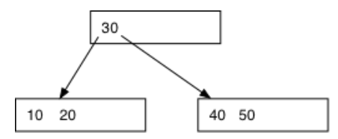
B-Trees
Insert 50
Steps:
Split node into two nodes
Put the smallest two elements in the left node
Put the largest two elements in the right node
Create a new root node and insert the middle value in it.

Slide 51
B-Tree Example
Construct a B-Tree of order with the following set of data:
Construct a B-tree with a maximum of 3 items per node for the following list of numbers
5, 3, 21, 9, 1, 13, 2, 7, 10, 12, 4, 8

Slide 52
Add 5
5
Add 3
3
5
Three parts because 3 elements are on each page, and this whole block is considered one page.
3 is before 5 because it is less than 5.

Slide 53
Add 21
3
5
21
Now this page is complete with 3 maximum elements.
Add 9
5
3
9
21
To add 9, we need to create a new page with the middle element of the previous page as a reference. With the help of BST property, the three will be at the left and 21 will be at the right. Now, to add 9 in the tree, it will go the right as well because 9<21 and 9 will come before 21.

Slide 54
Add 1
5
1
3
9
21
1 is less than 5, so left and is also less than 3 so it will be shifted.

Slide 55
Add 13
5
1
3
9
13
21

Slide 56
Add 2
5
1
2
3
9
13
21

Slide 57
Add 7
5
9
1
2
3
7
13
21
So to add 7, we will need to create 1 more page because the existing pages are full. But, to create that, we need to have 1 more element in the root page to create a new page. We cannot take 1, 2, 3 because they all are less than 5. so this page is already sorted.
If we take 13 or 21 other than 9, we will need to put 9 at the left side but we cannot do that because left side is already full so we needed to take a valid element. So we will take the smallest element on the left hand side of the page.

Slide 58
Add 10
5
9
1
2
3
7
10
13
21

Slide 59
Add 12
5
9
12
1
2
3
7
10
13
21
We created one more page? We append 12 and make sure we don’t mess up the order. We can’t keep the 10, 13 ,21 order because 10 is less than 12.

Slide 60
5
Add 4
2
9
12
1
3
4
7
10
13
21
We need to make all the ;evels equal, therefore, after creating 2 pages from the root element 2, we will make a sub page of 9 and 12 and then make the levels equal. Whatever is less than 5 will come at the left side.

Slide 61
5
Add 8
2
9
12
1
3
4
7
8
10
13
21

Slide 62
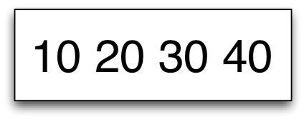
B-Tree
For example:
Tree of Order 2
Max number of items per page is 4
Insert 4 numbers

Slide 63
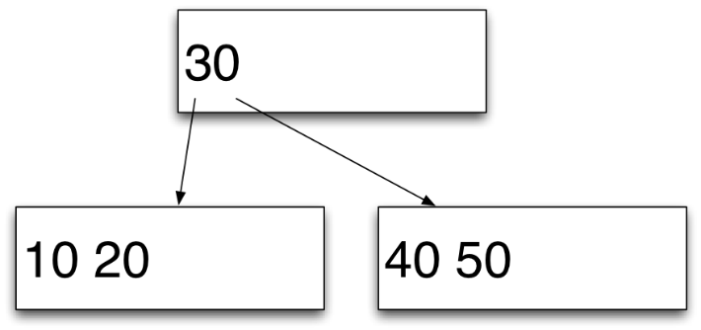
B-Tree
Insert 50
This causes us to:
Split the node in two
Place the smallest numbers in the left node
Place the largest numbers in the right node
Create a new root node and insert the middle value into it

Slide 64
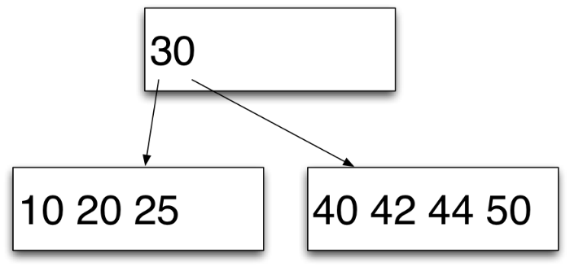
B-Tree
Insert 25, 42, & 44

Slide 65
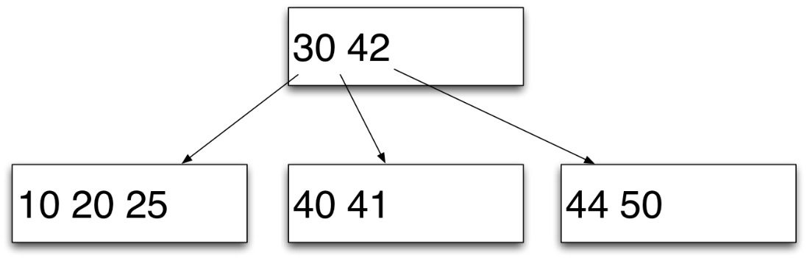
B-Tree
Insert 41

Slide 66
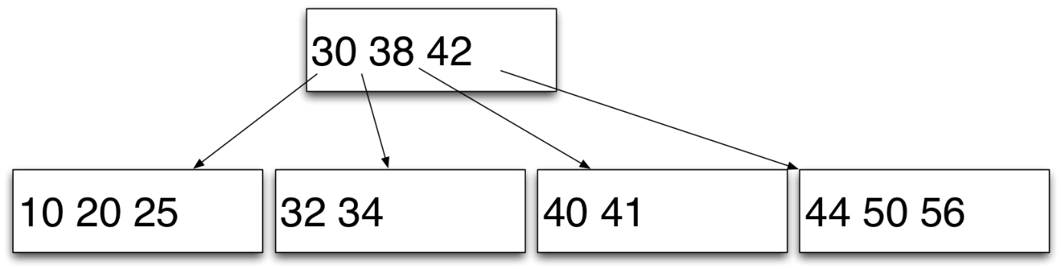
B-Tree
Insert 32, 38, 56, & 34
38 is in the root because what ever is les than 38 should be at the left hand side.

Slide 67
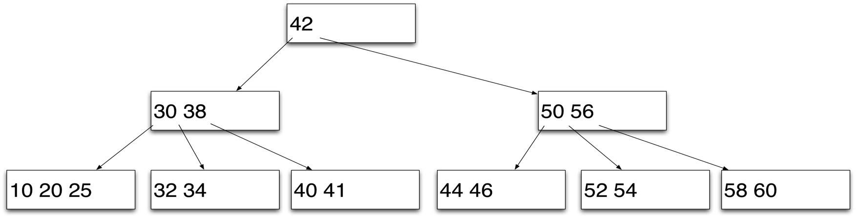
B-Tree
Insert 58, 60, 52, 54, & 46

Slide 68
B-Tree
Typical exam questions such as:
What do we mean by page size?
Construct a B-tree with a maximum of 4 items per node for the following list of numbers 1,3,….
Construct a B-tree of order 2 for the following list of numbers 1,3,….
The above 2 are the same question, both will have a max of 4 items per page

